Slide 1
Sky Replacement
Team 11
Members: 王領崧、陳伯瑾、朱偉綸

Slide 2
Outline
Motivation
Methods
Results & Analysis
Conclusion
Prospect
Reference

Slide 3
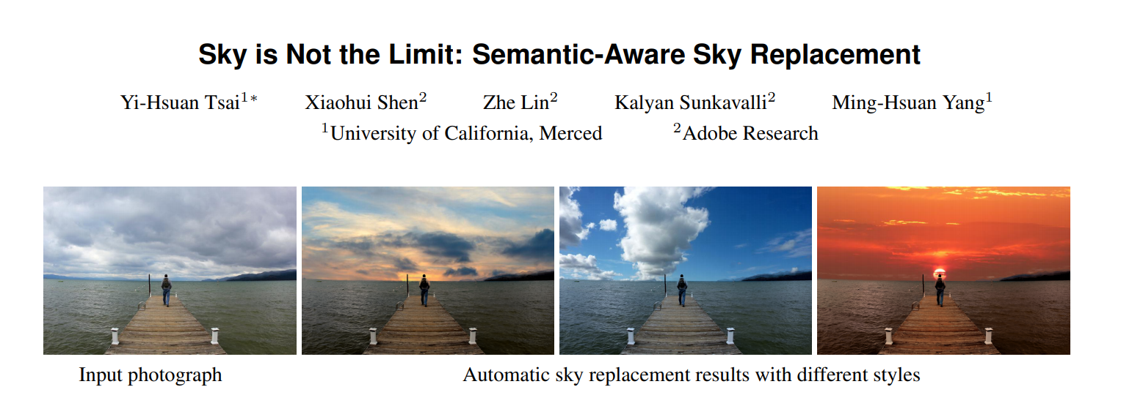
Movtivation
能不能不要用FCN?

Slide 4
Methods
Sky segmentation
Retrieve sky images
Realistic sky style transfer
Sky replacement
Boundary smoothing

Slide 5
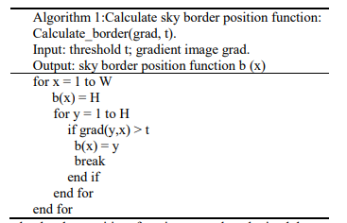
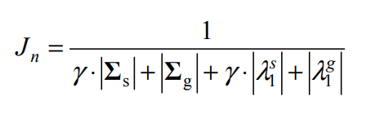
Sky Segmentation
調整threshold來達到optimal(max) Energy function
問題
接近窮舉的方式(跑很久還是沒有結果)
得到的結果未必是最佳解
能適用的範圍太小

Slide 6
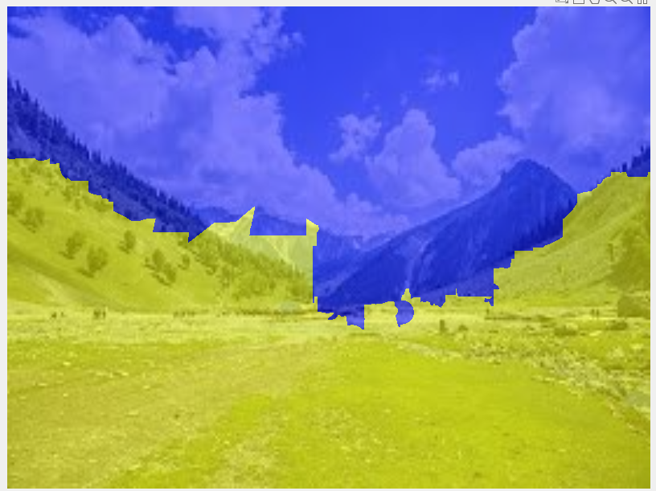
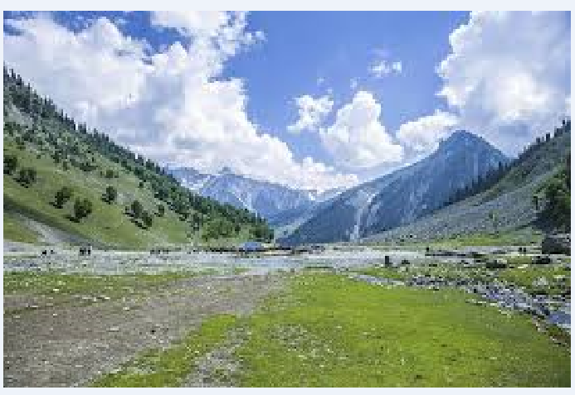
Sky Segmentation
Recursive Superpixel
Superpixel + Kmeans
問題
Superpixel的數量越少，分類的效果大幅下降(相鄰顏色過於相近，在分類的時候容易被汙染)
Superpixel是local comparison的演算法，有其限制
分出來的界線也會不太精準

Slide 7
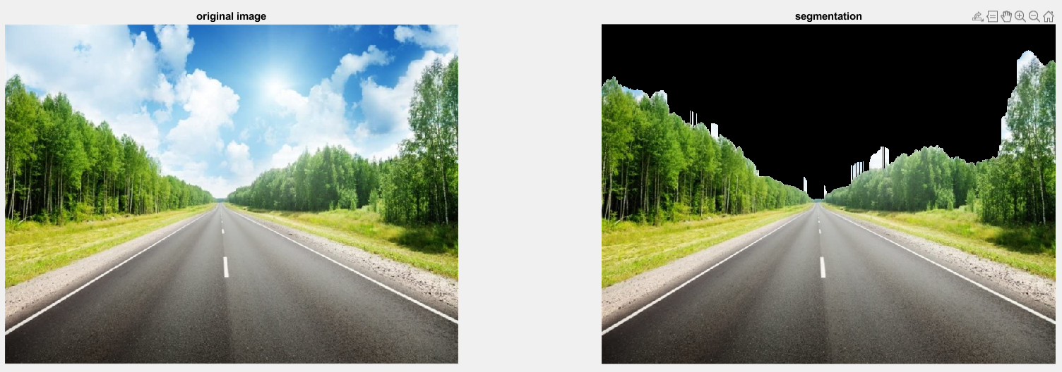
Sky Segmentation
Superpixel + hsv_threshold
Segmentation效果不錯(預設Input為山林風景圖)

Slide 8


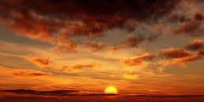

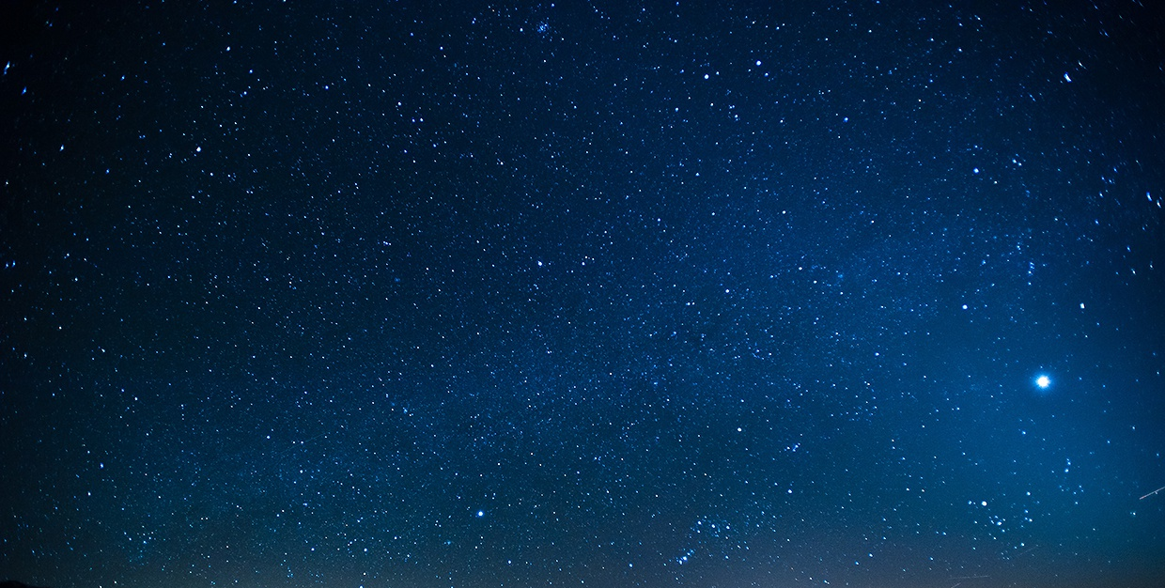
Retrieve Sky Image
clear
dusk
sunny
cloudy
night

Slide 9
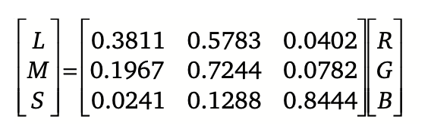
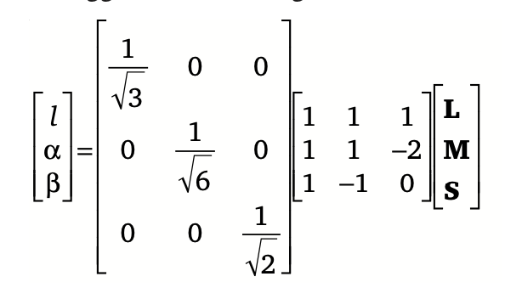
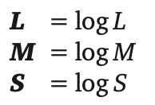
Realistic Sky Style Transfer
By Reinhard
Step1: Convert RGB to lab

Slide 10
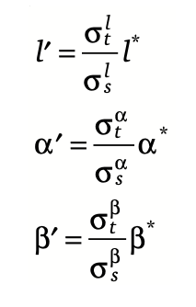
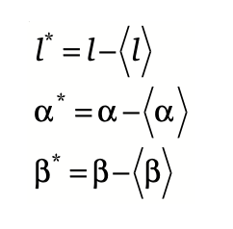
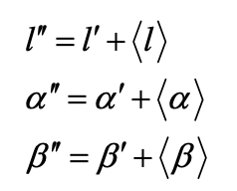
Realistic Sky Style Transfer
By Reinhard (cont.)
Step2: Adjusting means and standard deviations of the source image
mean of source image
mean of target image

Slide 11
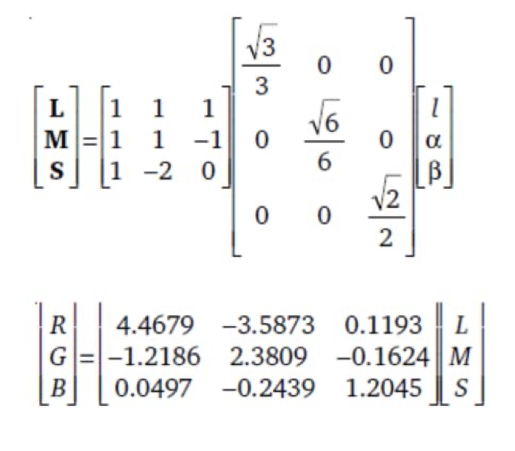
Realistic Sky Style Transfer
By Reinhard (cont.)
Step3: Convert lab back to RGB

Slide 12
Realistic Sky Style Transfer
By Reinhard (mod.)
Step1 & 3: Use matlab function rgb2lab , lab3rgb to convert
Step2: Adjusting means and standard deviations of the source image
mean of source image
mean of target image

Slide 13
Realistic Sky Style Transfer
By changing of intensity
Step1 & 3: Convert to HSV space
Use matlab function rgb2hsv , hsv3rgb to convert
Step2: Adjusting means and standard deviations of the “v” channel of source image

Slide 14
Realistic Sky Style Transfer
By histogram match
=> Call Matlab Function : imhistmatch(src_img , tgt_img)

Slide 15
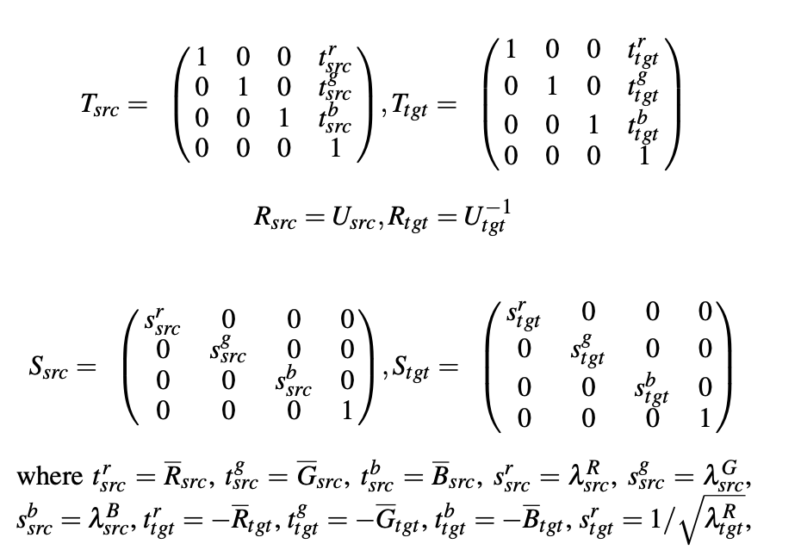
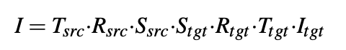
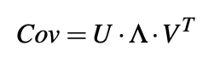
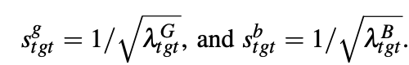
Realistic Sky Style Transfer
By Color Transfer in Correlated Color Space

Slide 16

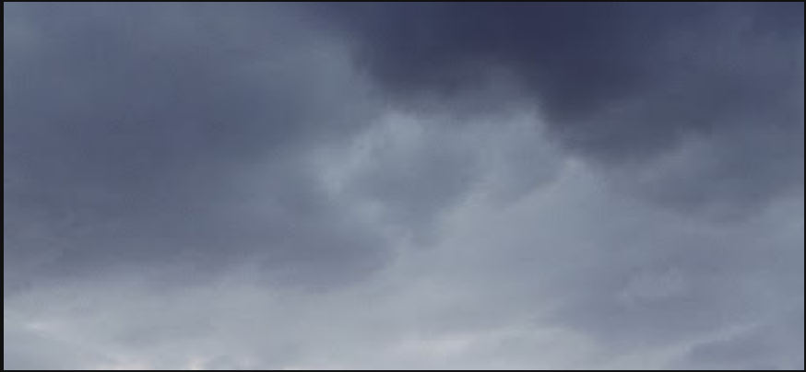



Realistic Sky Style Transfer
All color transfer way compare
original view
target sky

Slide 17
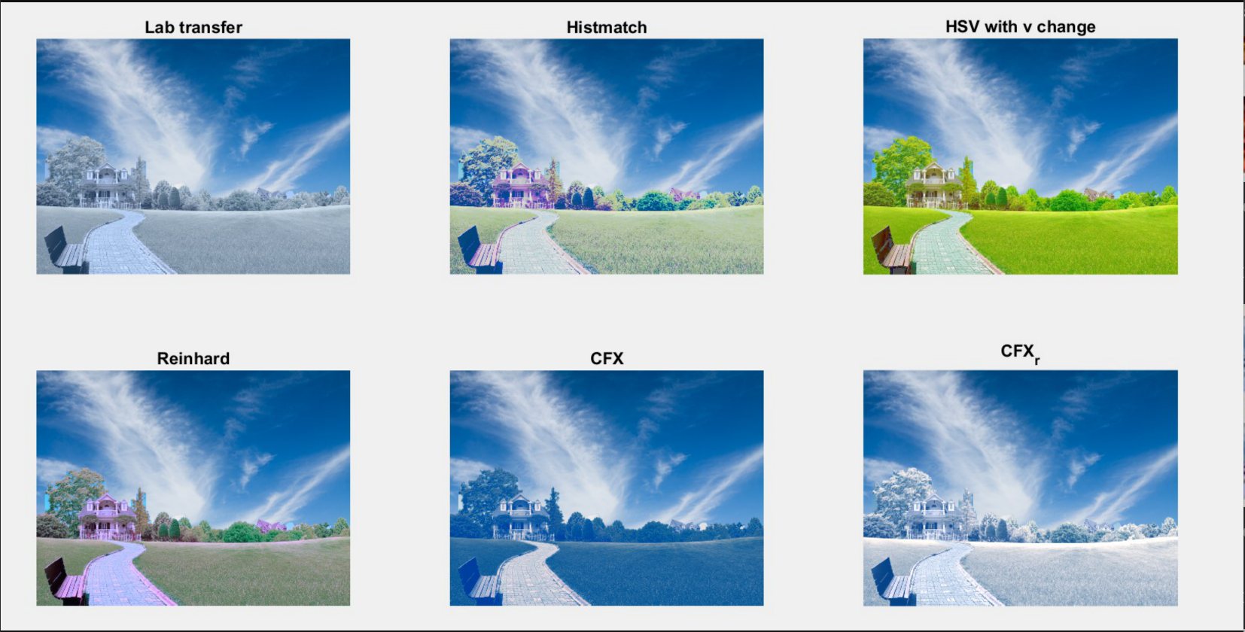
Realistic Sky Style Transfer
All color transfer way compare

Slide 18
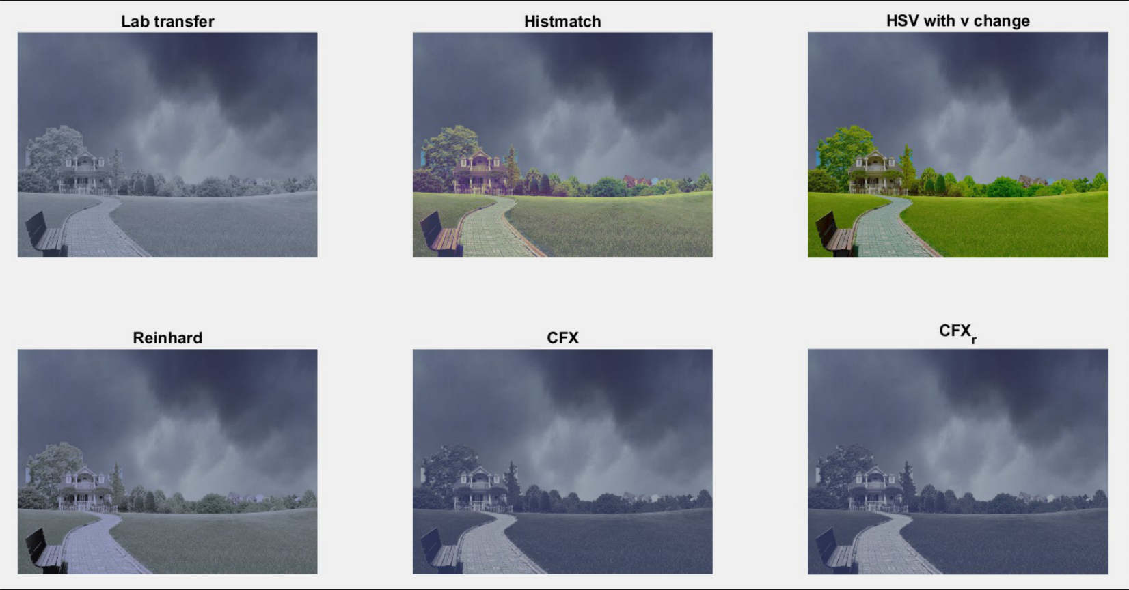
Realistic Sky Style Transfer
All color transfer way compare

Slide 19
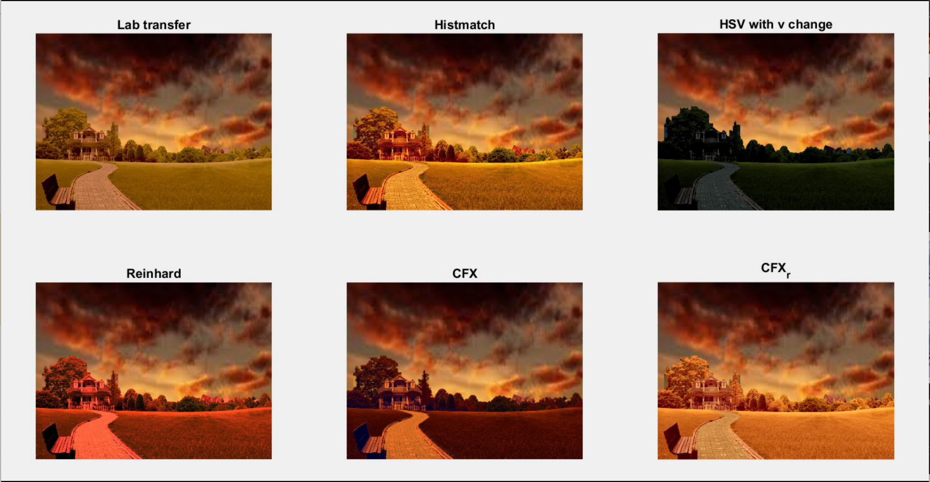
Realistic Sky Style Transfer
All color transfer way compare

Slide 20
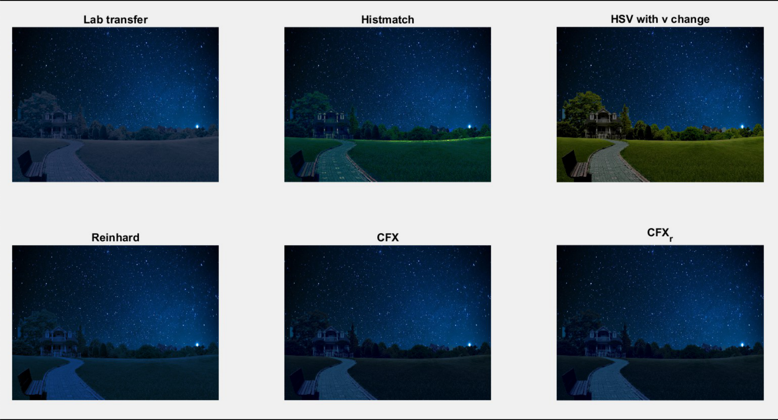
Realistic Sky Style Transfer
All color transfer way compare

Slide 21
Sky Replacement
依序掃過每一個column，將分界線以上的pixel替換為sky pixel

Slide 22
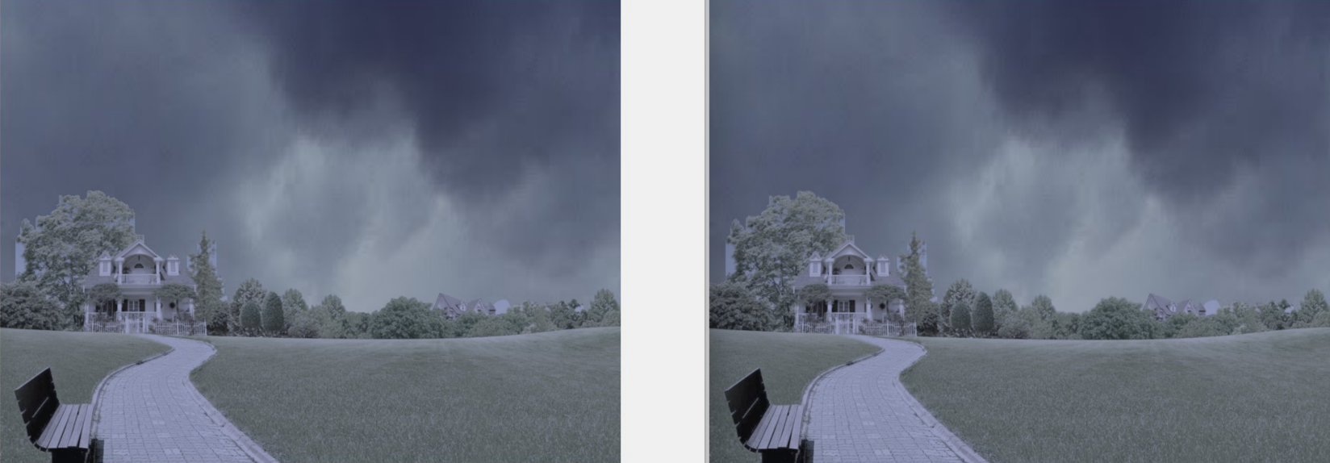
Boundary Smoothing
Box filter & Gaussian filter
Before
After

Slide 23
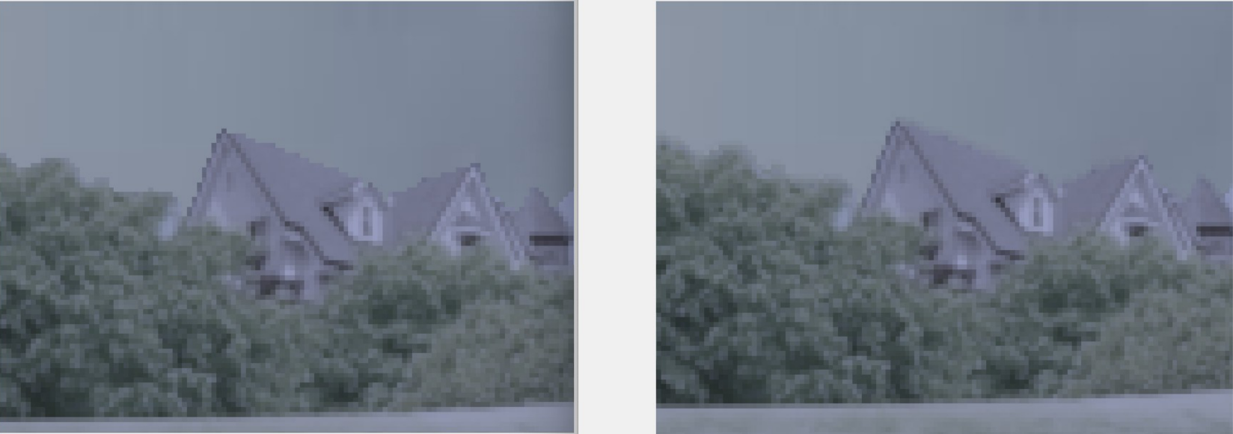
Boundary Smoothing
Box filter & Gaussian filter
Before
After

Slide 24
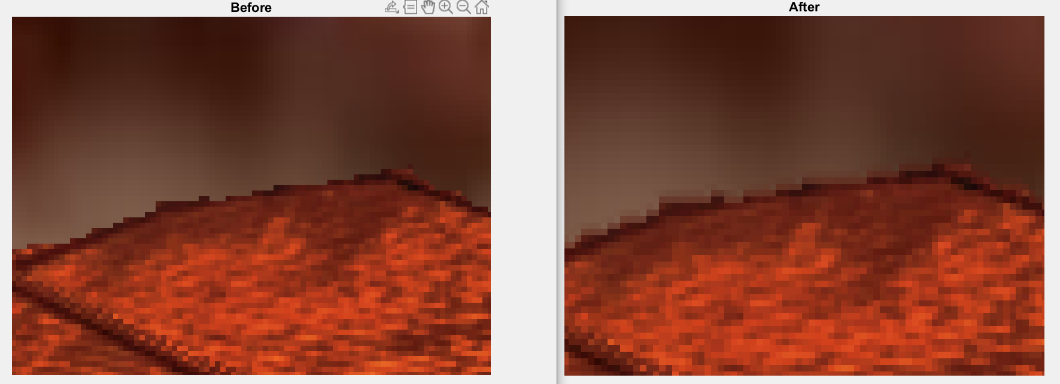

Slide 25
Results & Analysis

Slide 26
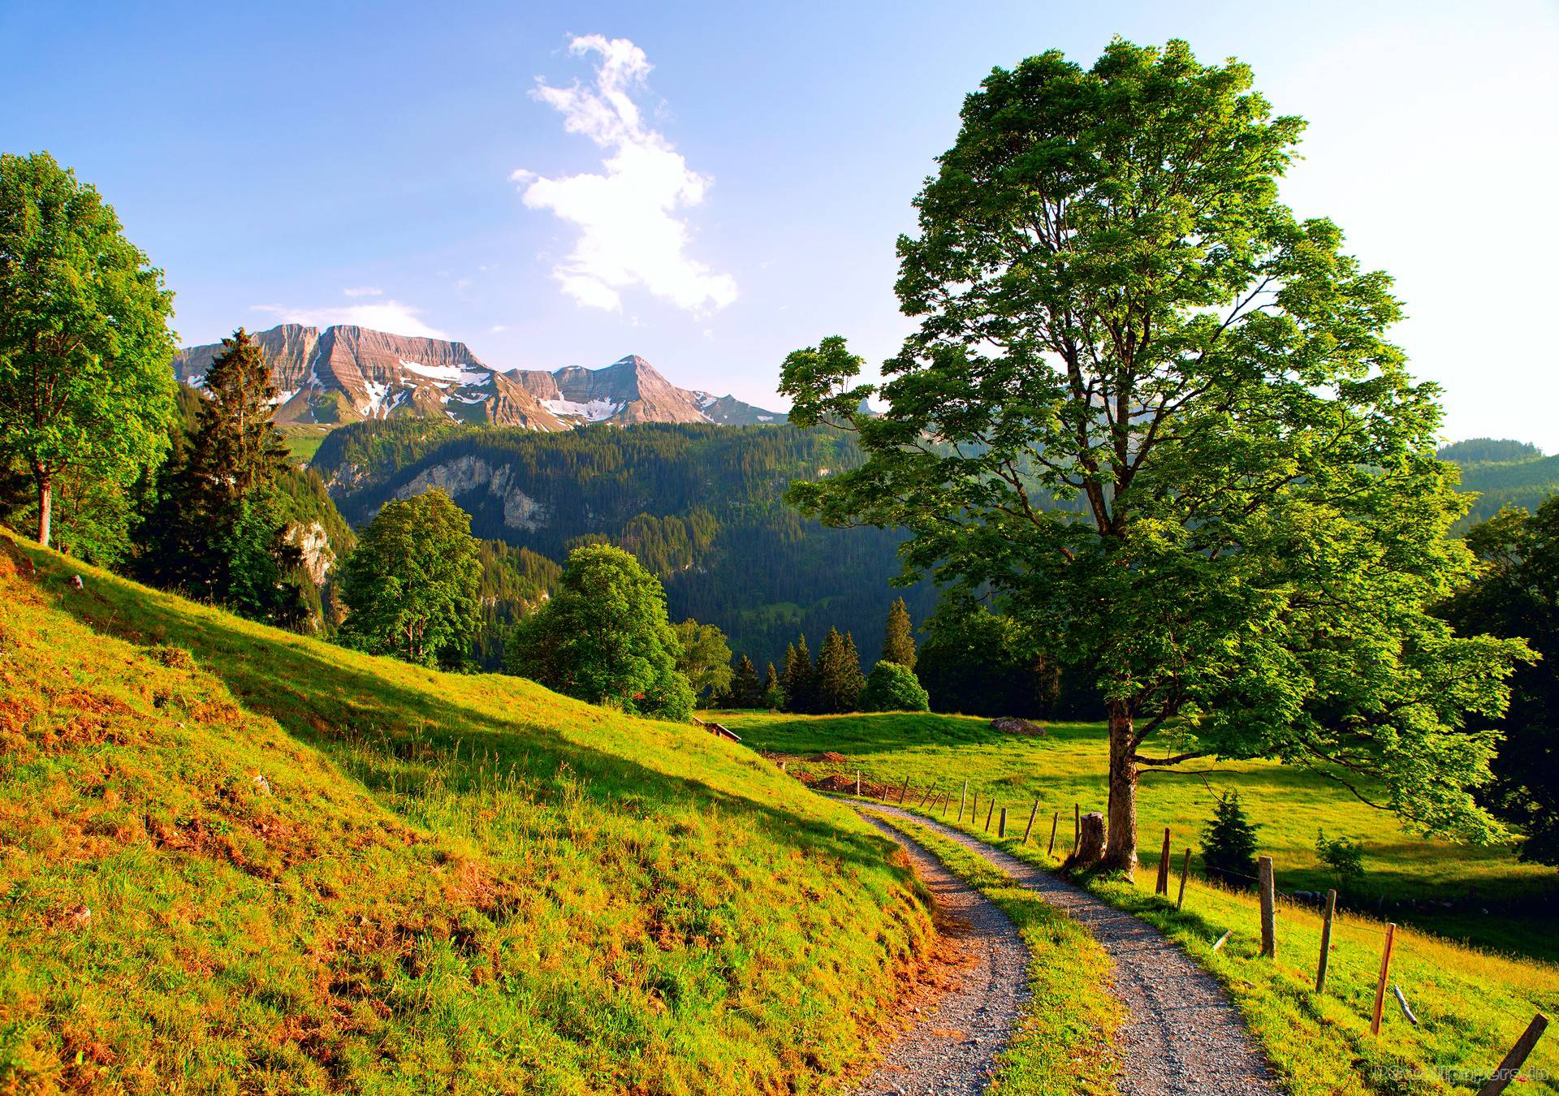
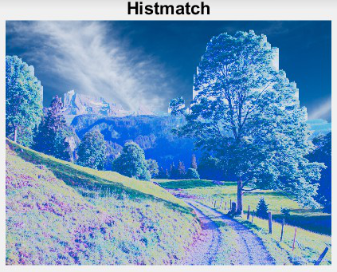
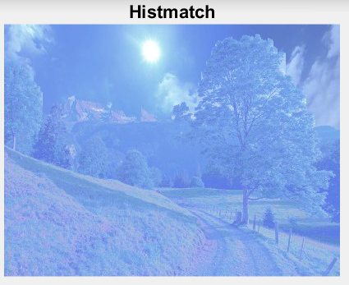
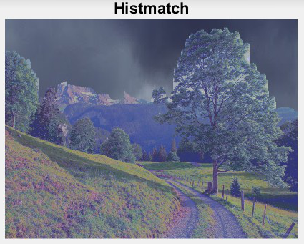
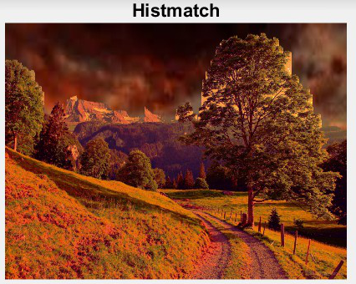
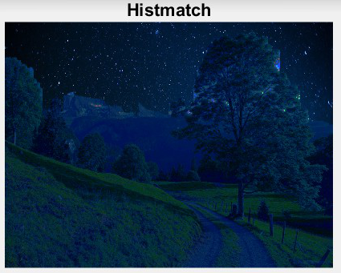

Slide 27

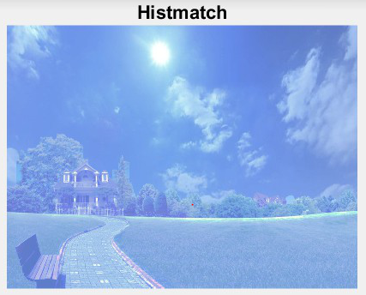
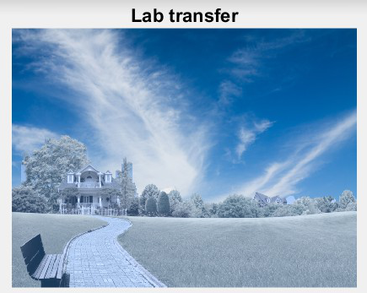
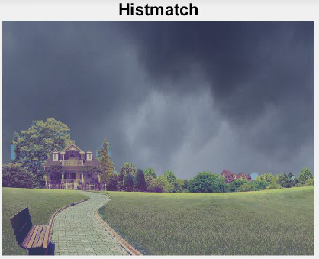
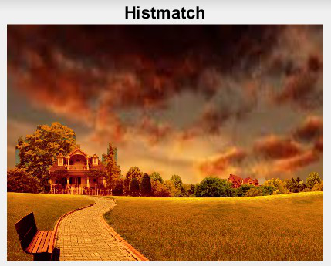
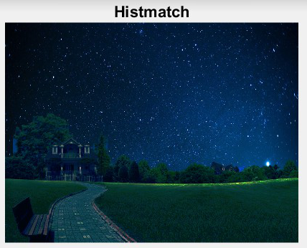

Slide 28
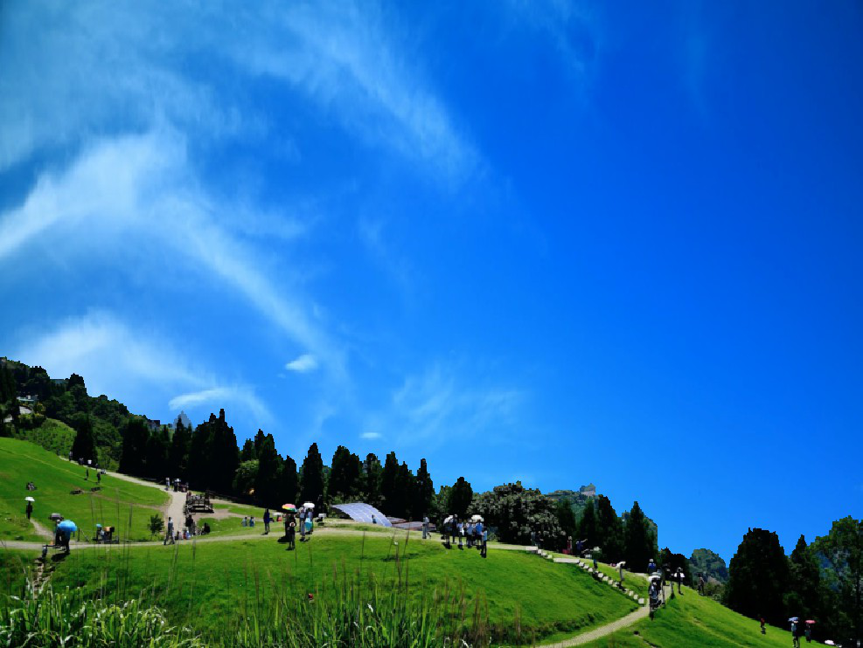
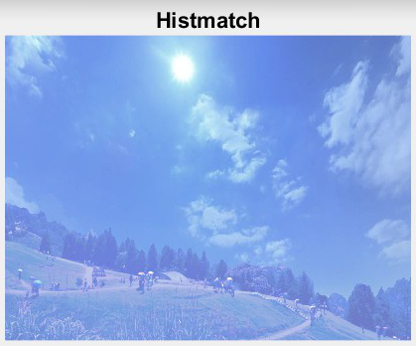
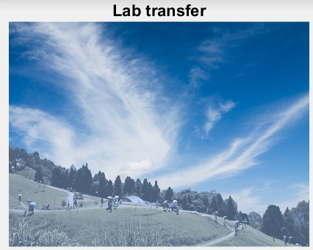
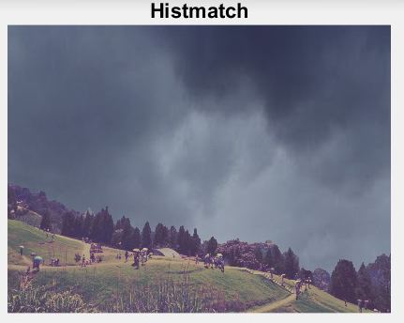
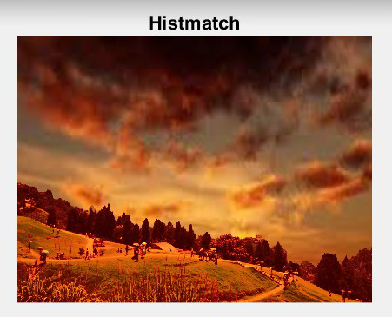
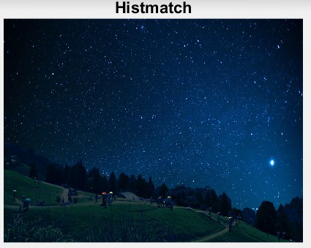

Slide 29
Conclusion
Sky Segmentation：Segmentation => 轉hsv space => 設threshold找boudary分出的結果較好
Sky Style Transfer : 整體上來說，histogram match的方式，結果多半較好

Slide 30
Prospect
Reference image可以更多樣化(e.g. 湖水圖)
自動針對不同的sky image，使用最好的sky style transfer method

Slide 31
Reference
http://article.nadiapub.com/IJSIP/vol8_no3/26.pdf
http://vllab.ucmerced.edu/ytsai/SIGGRAPH16/siggraph16_sky_edit.pdf
http://www.kalyans.org/research/2016/SkyReplacement_SIG16.pdf
https://ieeexplore.ieee.org/document/6703710
https://www.researchgate.net/publication/220805333_Color_transfer_in_correlated_color_space
https://www.researchgate.net/publication/221523265_Progressive_histogram_reshaping_for_creative_color_transfer_and_tone_reproduction
https://journals.sagepub.com/doi/pdf/10.5772/56884
https://github.com/SaumyaRawat/Semantic-Aware-Colour-Transfer/blob/master/Report.pdf
https://www.mathworks.com/matlabcentral/fileexchange/42580-reinhard-stain-normalization

Slide 32
Reference
https://www.jianshu.com/p/421f4171d48a
https://blog.csdn.net/sin_geek/article/details/45723475
https://www.cs.tau.ac.il/~turkel/imagepapers/ColorTransfer.pdf
https://www.mathworks.com/help/images/histogram-equalization.html
https://ieeexplore.ieee.org/stamp/stamp.jsp?tp=&arnumber=6909823
https://wenku.baidu.com/view/4dcb5643336c1eb91a375dbc.html
https://medium.com/codezest/super-fast-color-transfer-algorithm-bd1a76bc7619
https://static.aminer.org/pdf/PDF/000/540/062/rendering_natural_waters.pdf
http://www.yxkxyghx.org/EN/abstract/abstract2352.shtml

Slide 33


